Slide 1
INITIAL PITCH IDEAS
Robbie and Estrella

Slide 2
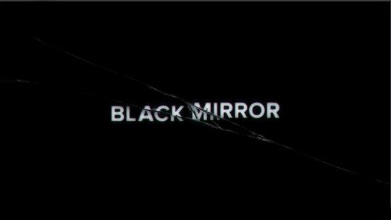
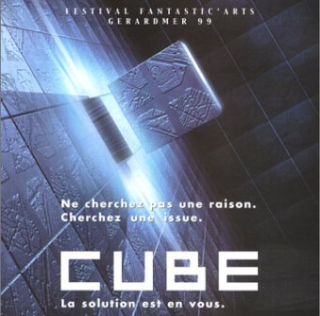
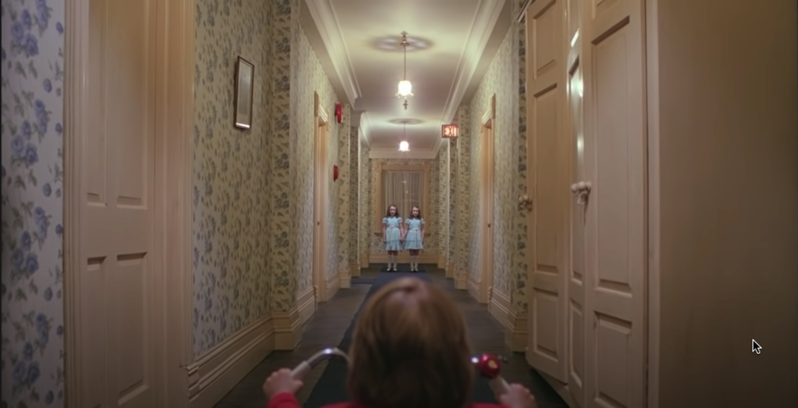
GENRE
The opening scene of the film we have created was inspired by films and TV shows with similar genres such as:
The genre that we have chosen is that of the physiological thriller. We believe that this genre yields the most unique scenarios for the opening scene of a film and there are a multitude of creative ways we can establish the cinematography.

Slide 3
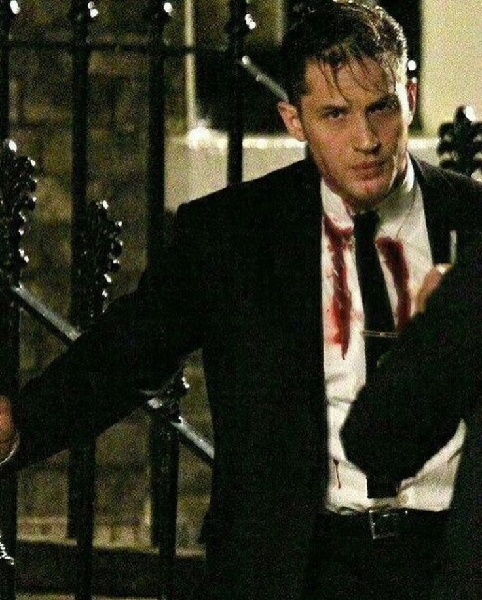
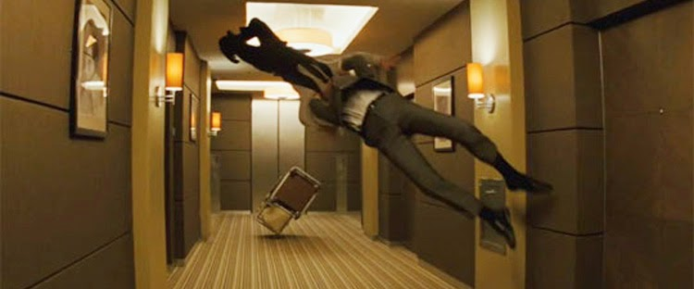
INSPIRATION
Location : Another inspiration that came from our film (specifically, where the film should take place) is Inceptions iconic corridor scene. It emits the right ambience that we wish to capture in our opening scene.
Costume : Our character inspiration is a man waking up at the end of the corridor tied up wearing a suit, covered in blood and sweat.

Slide 4
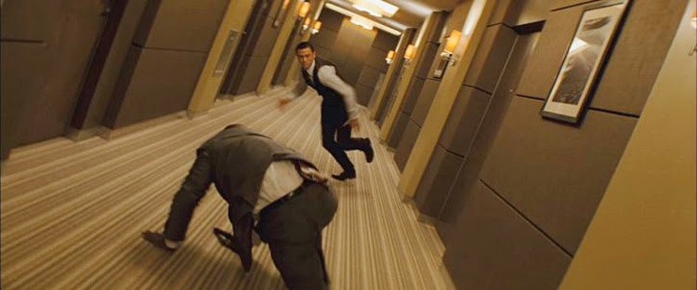
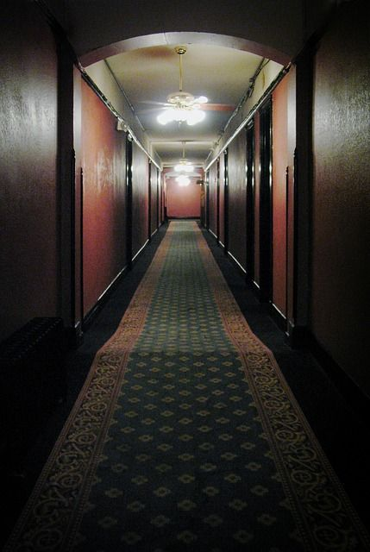
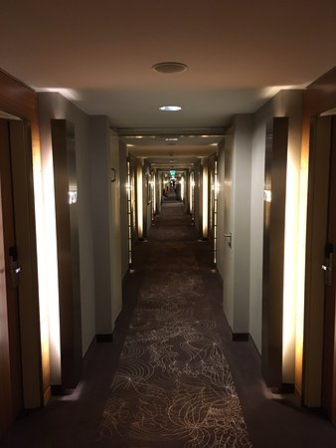
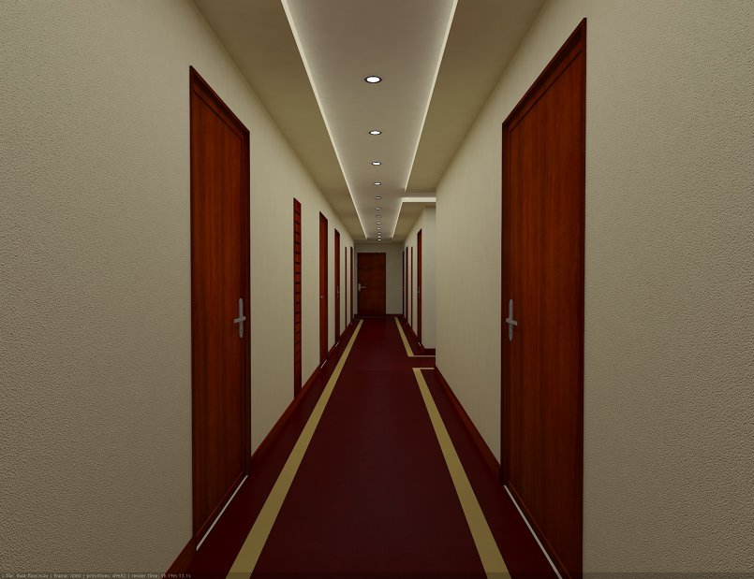
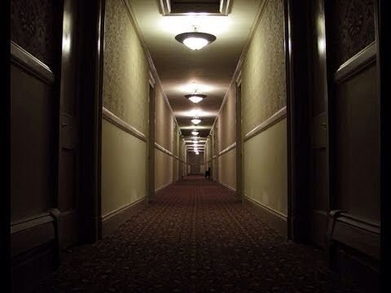
LOCATION
We will try recreating our inspiration which is the Inception corridor fight scene with a hotel in Madrid. The more eerie the better yet it could also look pretty modern to add to this kind of experimental feel of the film, almost futuristic in a sense.

Slide 5
THE TITLE OF OUR FILM :
‘The Experiment’ (Alegreya)
‘The Experiment’ (Rozha One)
‘The Experiment’ (Bad Script)
‘The Experiment’ (Shadows into light)
We believe that this is the most fitting title for our film as (at least in our opinions) it perfectly encapsulates the overall tone of the film, it is purposefully vague (much like the purpose of the location of put film)

Slide 6
To allow the audience to possess a better understanding of the protagonist
Encourages the audience to be literally against the protagonist, he cannot escape and the fish eye lens makes it seem like the audience is playing a part in his captivity.
FLASHBACKS??
FISH EYE LENSE
FLASHBACKS
FISH EYE LENS
CODES AND CONVENTIONS
So the audience can better understand the environment that the character occupies
CONTRAPUNTAL MUSIC
SECURITY CAMERA FOOTAGE
To evoke unease in the audience and set up suspense
CONTRAPUNTAL MUSIC
SECURITY CAMERA FOOTAGE

Slide 7
Dazed and confused, the man is released from his shackles and begins to wander further into a corridor. Around him is a single flower pot placed upon a squat table, several doors which do not open and the piercing lens of a security camera, watching his every move. He begins to panic, and as he meets the end of the corridor, he finds an elevator. He has constant voices in his head because he is schizophrenia.
The plot of our film is as such: A man in a suit, drenched in blood, wakes up to find himself tied up in a chair. He is complete darkness, however seconds after he become conscious, light around him flicker on. An eerily robotic voice fills the room, telling the man that he is experiment #10856 and that his aim is to reach the end of the maze.
His descent into madness is exemplified by him going up more and more floors, but to no avail in his escape. Eventually he comes to a floor with a dark, pitiless end to it instead of an elevator. He enters it, finds a briefcase, opens it to just cut to his face in shock and the lights turn off and it then cuts to the beginning of the maze, where a group of people are shown to be in the exact same position he was.
Once he enters it, the doors shut behind him and he ascends, with unfitting elevator music to accompany his claustrophobic journey. The doors open and he finds himself in an identical corridor, with an elevator on the other side as well. He runs to the corridors starting to go mad and smashes the flower pot out of rage which then remains intact the second time he re enters this floor loop.

Slide 8
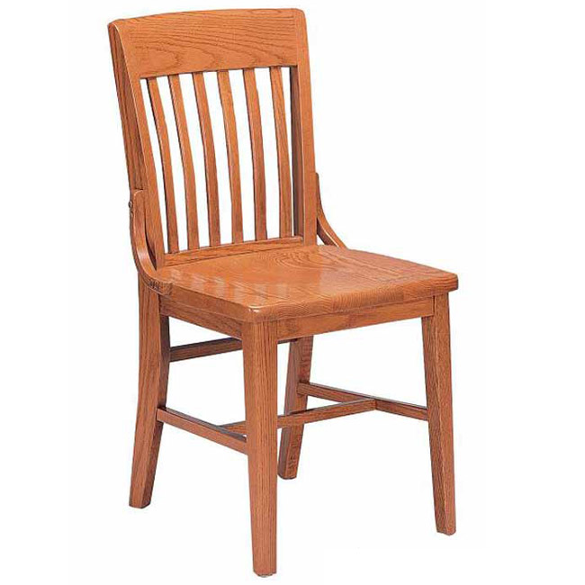
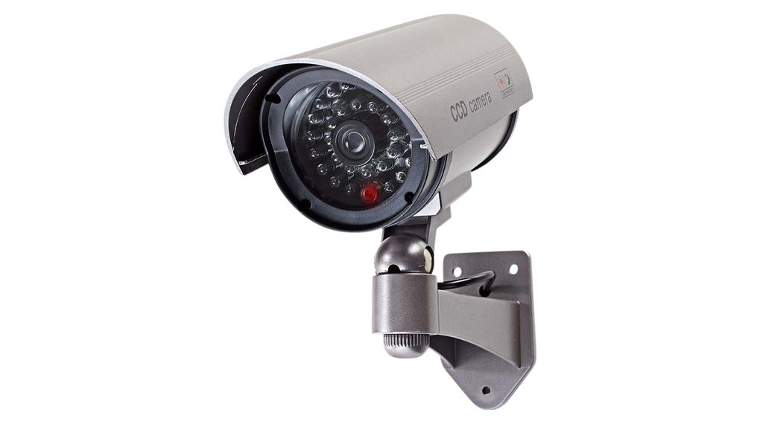
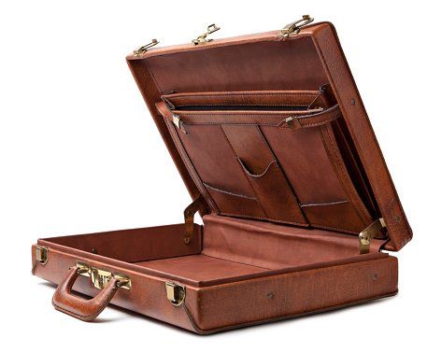
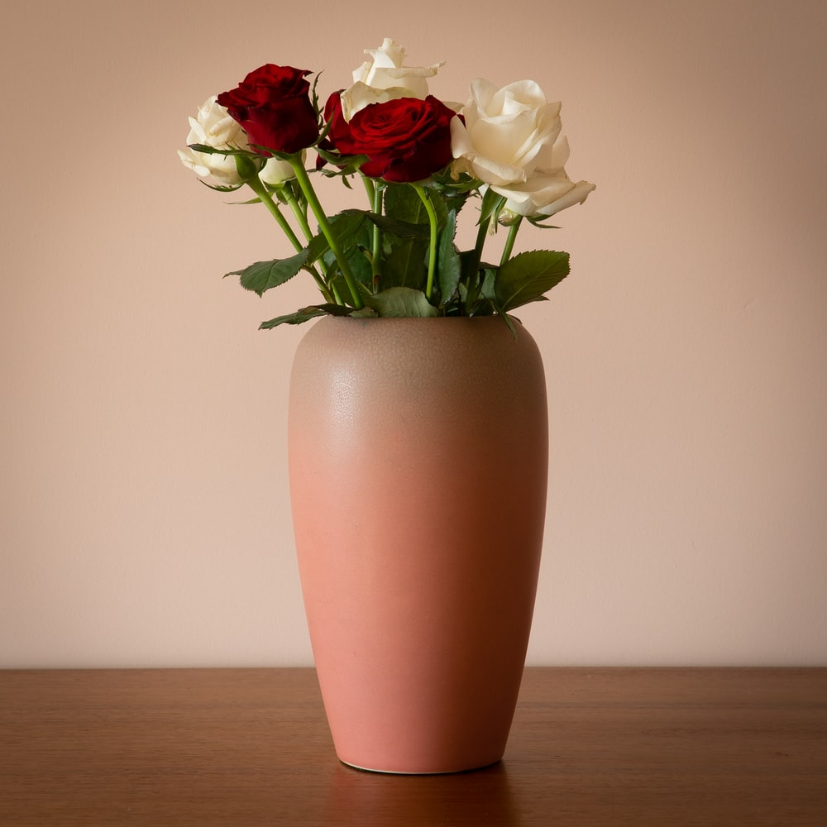
PROPS
Every single prop that will be placed in the opening scene will be put there for a reason with a small message behind it.
The security camera for example will be put to highlight the fact that he is being watched by someone on the outside, the mysterious case is put there to have the audience constantly curious about what's inside since it is never shown what's inside and the flower vase is put there to show the never ending loop he's in since when he smashes it it looks perfectly intact the second time he enters the same corridor loop again, the chair as this is the first place we see the main character and wonder how he got there.

Slide 9
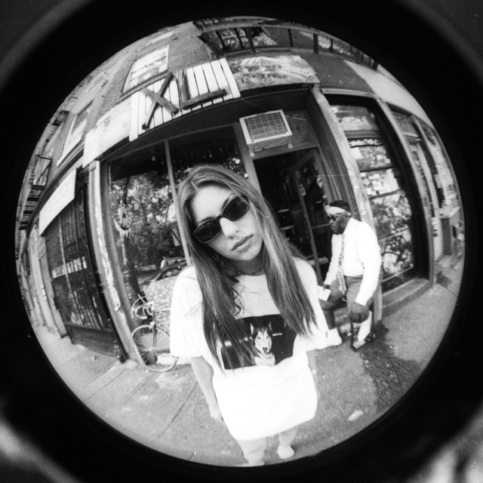
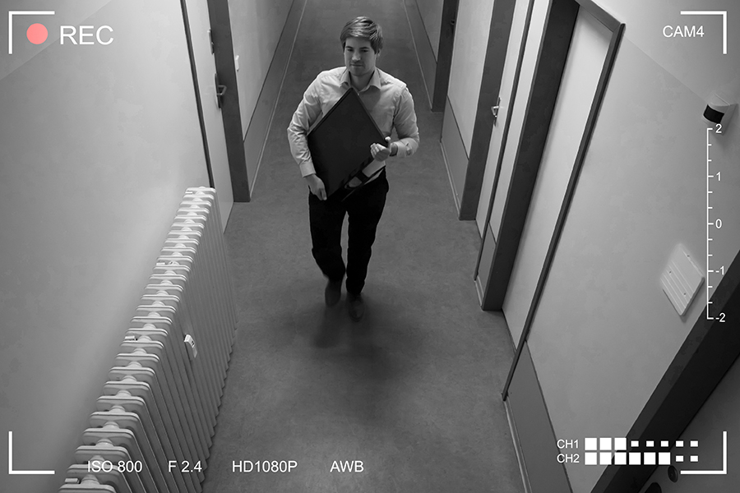
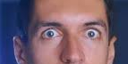
CAMERA
Close ups to only his eyes as he opens the briefcase to add mystery to this as the audience never fully knows what's actually inside of the briefcase and can only try to figure it out through the man's facial expressions
Fisheye lens for when he is looking into the doors trying to open them initially positioning the audience inside of the locked rooms while watching the main character suffer
Security camera footage from a high angle shot showing how the character is helpless and inferior to the audience

