Slide 1
The title of our film
A research report conducted by Robbie

Slide 2
The research page
How the plot and Mise-en-scene of our film affects the title
Click the blue text to see the research in each category
The title of our film
The research conducted into how other directors and writers within a film reached to their title. (What steps were taken to solidify their title)
What other factors have been incorporated alongside the title to exemplify the nature of the title

Slide 3
Finally, the title of our film is….
The Experiment

Slide 4
Seeing as the plot of our film contains horrific and mysterious elements, the title would need to be vague and ominous in some way.
The Mise-En-Scene in the opening scene of our film contains many indicators that the maze is menacing.
The fact that the character is seemingly killed at the very end of the opening scene means he no longer has importance to the plot.
The frame and character blocking featured when it focuses on the protagonist is suggesting that the maze is in control at all times, almost as if it is more important than he is.
Back to R.P
Due to these specific aspects in both elements of cinematography, the title should be solely in regards to the maze itself and its control over its subjects.

Slide 5


The color pallet and sound playing alongside the introduction creates or encourages the audience to understand or experience the title.
Moreover, the score that shall be incorporated once the title is revealed to the audience will be that of non diegetic classical piano music followed by a piercing, lone sound effect.
This specific color scheme will be used in the title itself. It allows for the audience to understand three things:
1. That there is division in the film that plays a key role in understanding the film
2. That the color white represent peace, however the contrast created with the color black suggests that there is a sinister force at work in the film
3. That the genre of this film is related to horror and mystery.
The sinister black force is hidden, like something would be hidden from the audience in a mystery film.
The classical piano music acts as a sound bridge between the final shot of the opening scene, into the title card
Back to R.P
Sound layering will also be present whilst the title is onscreen, with the two other sounds playing whilst the sound of growing footsteps is also playing in the background (to evoke unease in the audience)
The color red connotes danger and blood, themes that are usually heavily prominent in horror films.

Slide 6

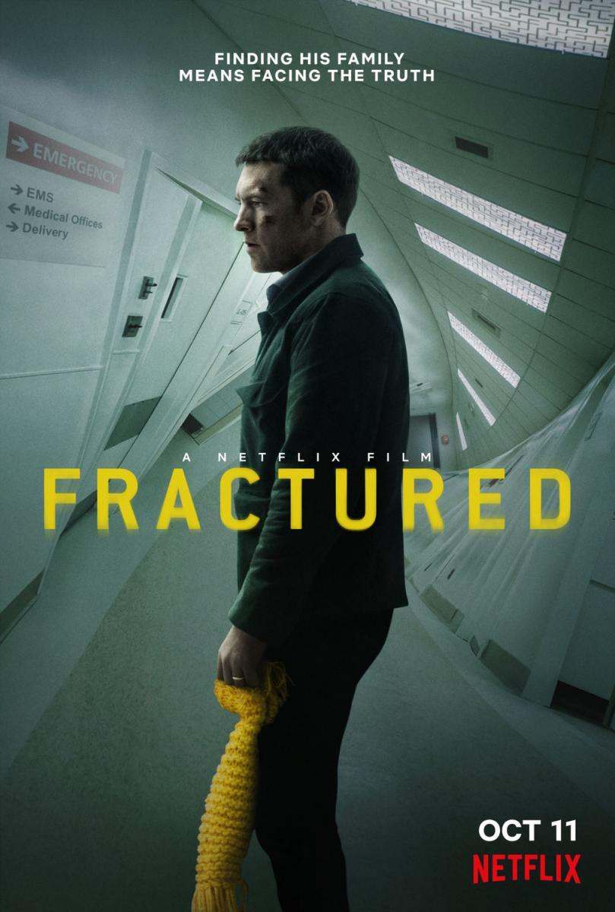
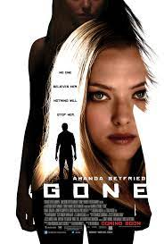
This physiological thriller (combined with the color pallet and themes of the film) has a title that creates an eerie atmosphere, as the juxtaposition between a person's name and the horrors the audience has endured during the opening scene induces immense unease.
The word fractured could easily be used to describe the state of someone's psyche, which is exactly what this film is attempting to convey.
Back to R.P
The effect and ideas a film title will convey vary between their key themes. For example:
The title here immediately encourages the audience to jump to conclusions, it is setting up their expectations and might contain a plot twist within the film, completely subduing these expectations. This idea stems solely from the title.

